Slide 1
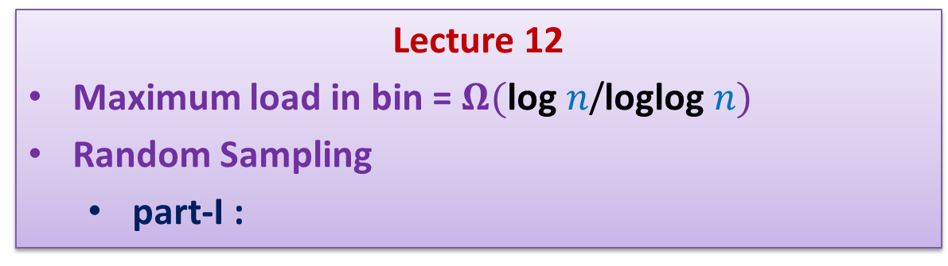
Randomized Algorithms CS648
Lecture 12
Maximum load in bin = $Ω(\text{log} n\text{/}\text{loglog} n)$
Random Sampling
part-I :
Estimating a parameter

Slide 2

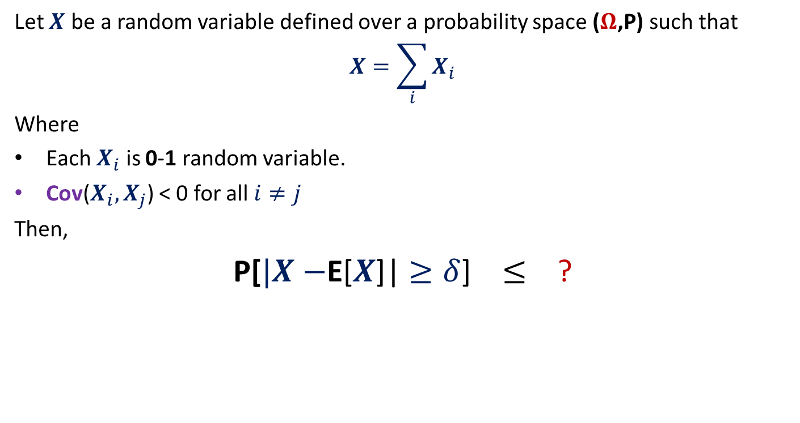
Theorem
Let $X$ be a random variable defined over a probability space ($Ω$,P) such that
$$X=\sum_{i}{X_{i}}$$
Where
Each $X_{i}$ is 0-1 random variable.
Cov($X_{i},X_{j}$) < 0 for all $i≠j$
Then,
P[$|X−$E[$X$]| $≥δ$] $≤$ ?
$$\frac{\text{E}\text{[}X\text{]}}{δ^{2}}$$

Slide 3


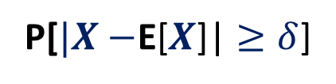


Maximum load is $Ω(\text{log} n\text{/}\text{loglog} n)$
P(bin $j$ has at least $k$ balls)
≥ P(bin $j$ has exactly $k$ balls)
=$\left(\begin{matrix}n \\ k\end{matrix}\right)∙{{(\frac{1}{n} )}^{k} ∙(1−\frac{1}{n} )}^{n−k}$
≥ ${(\frac{n}{k} )}^{k}{{∙(\frac{1}{n} )}^{k} ∙(1−\frac{1}{n} )}^{n}$
≥ ${\frac{1}{4}∙(\frac{1}{k} )}^{k}$
For $k$ = ? , the value of ${(\frac{1}{k} )}^{k}≥n^{−1/4}$
$$\frac{\log{n}}{4 loglog n}$$
Theorem
$$≤ \frac{\text{E}\text{[}X\text{]}}{δ^{2}}$$
P[$|X−$E[$X$]| $≥δ$]

Slide 4


How to use Theorem ?
$X$: the number of bins with at least $\text{log} n\text{/}\text{4} \text{loglog} n balls$
‘‘$X=0$’’ = “There is no bin with $\text{log} n\text{/}\text{4} \text{loglog} n or more balls$”
Let $X_{j}$ be the random variable defined as follows.
$$X_{j}= \left\{\begin{aligned}1 if j th bin has at least \text{log} n\text{/}\text{4} \text{loglog} n balls \\ 0 otherwise \end{aligned}\right.$$
P[$X_{j}=1$] $≥n^{−1/4}$
E[$X$] $≥n^{3/4}$
P[$X=0$]
= P[$X−\text{E}\text{[}X\text{]}=−\text{E}\text{[}X\text{]}$]
$≤$P[$|X−\text{E}\text{[}X\text{]}\text{|}=\text{E}\text{[}X\text{]}$]
$≤$ P[$|X−\text{E}\text{[}X\text{]}\text{|}≥\text{E}\text{[}X\text{]}$]
$≤$ $\frac{1}{\text{E}\text{[}X\text{]}}$
Theorem
$$≤ \frac{\text{E}\text{[}X\text{]}}{δ^{2}}$$
P[$|X−$E[$X$]| $≥δ$]
$$≤n^{−3/4}$$

Slide 5
Rumor spreading

Slide 6
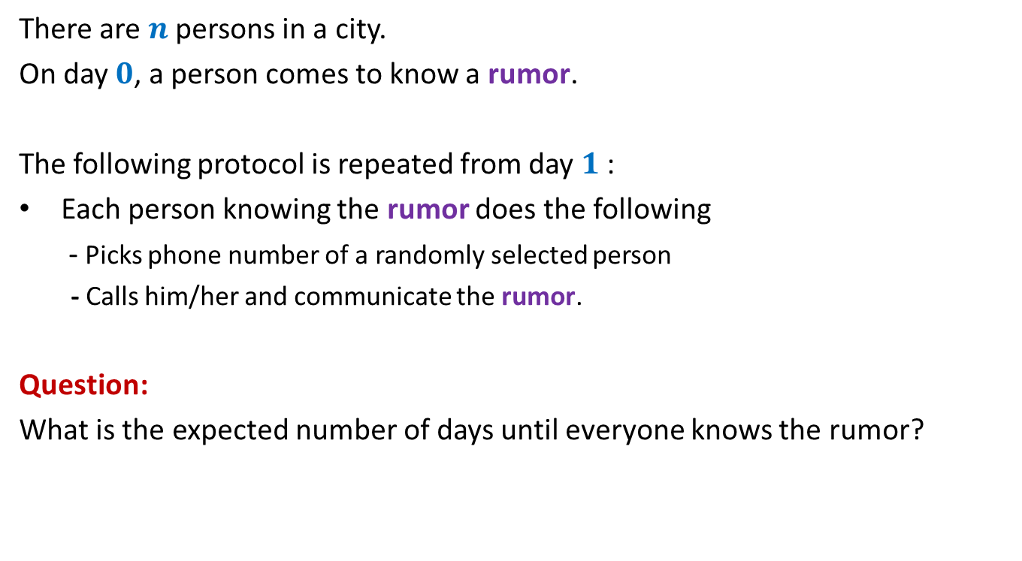
Rumor Spreading
There are $n$ persons in a city.
On day $0$, a person comes to know a rumor.
The following protocol is repeated from day $1$:
Each person knowing the rumor does the following
- Picks phone number of a randomly selected person
- Calls him/her and communicate the rumor.
Question:
What is the expected number of days until everyone knows the rumor?

Slide 7

Rumor Spreading
Question:
What is the minimum number of days until everyone knows the rumor?
Answer: $log_{2}n$
Number of people knowing the rumor can only double in a day.

Slide 8

Rumor Spreading
Theorem :
The entire city comes to know the rumor in O($log_{2}n$) expected days.
With high probability as well.

Slide 9
Announcement
Mid semester exam
22nd February, 13:00 – 15:00
Venue: RM101 (and NOT L2)
16:00 ?

Slide 10
Random sampling for
estimation of a parameter
Number of balls from a bag
Size of transitive closure of a directed graph

Slide 11
Problem 1
Estimating
the number of Balls in a BAG

Slide 12

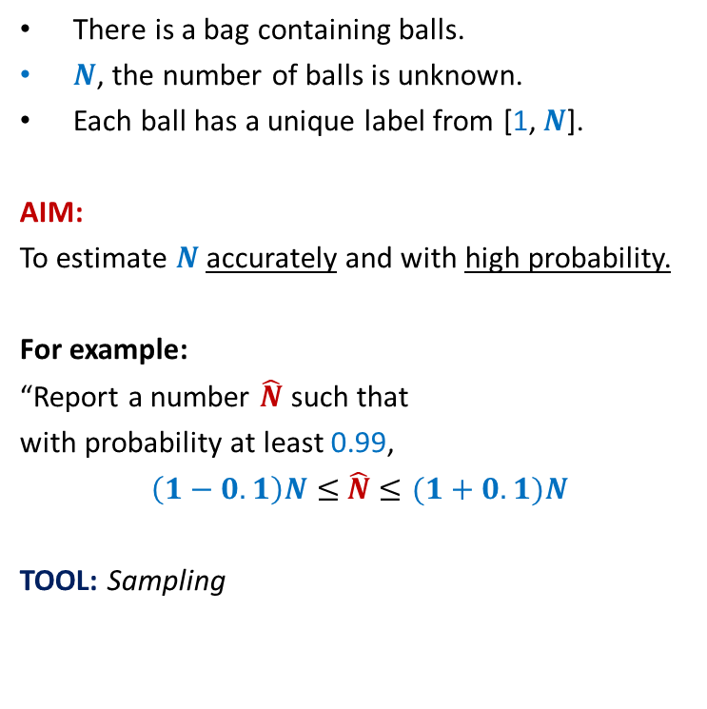
Estimating the number of Balls in a BAG
There is a bag containing balls.
$N$, the number of balls is unknown.
Each ball has a unique label from [1, $N$].
AIM:
To estimate $N$ accurately and with high probability.
For example:
“Report a number $\hat{N}$ such that
with probability at least 0.99,
$\left(1−0.1\right)N≤$ $\hat{N}$ $≤(1+0.1)N$
TOOL: Sampling
n
:
t
q
l
:c
:
:
l
5
:
2
4
j
3
1
:
i
:
:

Slide 13

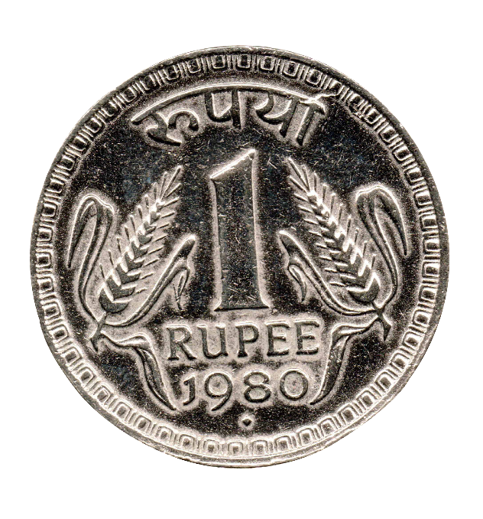


Estimating probability $p$of getting head
Given any $ε,δ>0$
Compute a number $\hat{p}$ such that
$\left(1−ε\right)p≤$ $\hat{p}$ $≤\left(1+ε\right)p$
With probability at least $1−δ$
Homework: After today’s lecture, solve this problem.

Slide 14

Estimating the number of Balls in a BAG
IDEA:
The label of sampled ball provides some info.
$X$ : the label of the sampled ball.
Question: What is E[$X$] ?
Answer:
E[$X$]$=\sum_{i}{i⋅P(X=i)}$
$=\sum_{i}{i⋅\frac{1}{n}}$
$=\frac{1}{n}\sum_{i}{i} = \frac{\left(n+1\right)n}{2n}$ = $\frac{n+1}{2}$
n
:
t
q
l
:c
:
Can we use it to design an algorithm ?
:
l
5
:
2
4
j
3
1
:
i
:
:

Slide 15

Estimating the number of Balls in a BAG
A simple algorithm:
Pick a ball randomly uniformly from the bag.
Let $t$ be its label.
$\hat{N}$ ←$2t−1$.
Report $\hat{N}$ .
n
:
t
q
l
:c
:
:
l
5
:
2
4
j
3
1
:
i
:
:

Slide 16


How good is the estimate ?
Question: What is P($\hat{N}$ $<N/2$) ?
Answer: $\frac{1}{4}$
Question: How to reduce the error probability ?
Answer:
1
2
$$N/4$$
N-1
N
multiple sampling.

Slide 17



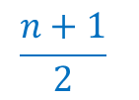
Multiple samplings to improve accuracy and reduce error probability
{ $5 , 23 , 69 , 73 , 110 , 129 , 135 , 154 , 195$}
$$k=9$$
Question: Which sampled ball is most likely to have label closest to $(n+1)/2$ ?
Question: What is the expected number of sampled balls with label $≥(n+1)/2$ ?
Answer: $k/2$ .
1
2
N
$$\frac{n+1}{2}$$
$$\frac{k}{2}$$

Slide 18
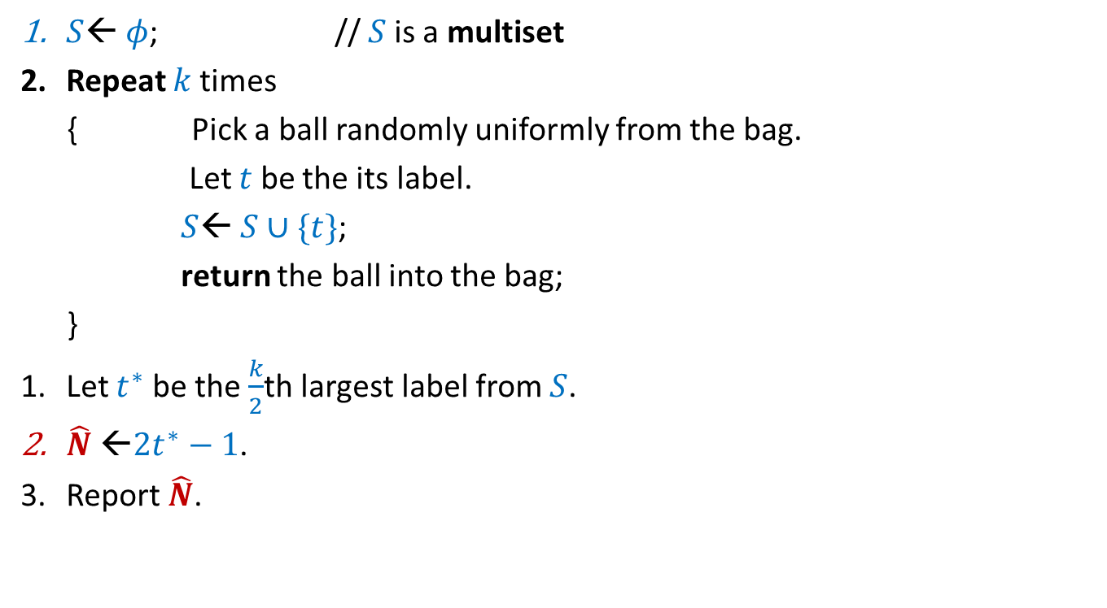
A better algorithm for estimating the number of balls:
$S$← $φ$; // $S$is a multiset
Repeat $k$times
{ Pick a ball randomly uniformly from the bag.
Let $t$ be the its label.
$S$← $S∪\{t\}$;
return the ball into the bag;
}
Let $t^{∗}$ be the $\frac{k}{2}$th largest label from $S$.
$\hat{N}$ ←$2t^{∗}−1$.
Report $\hat{N}$.

Slide 19
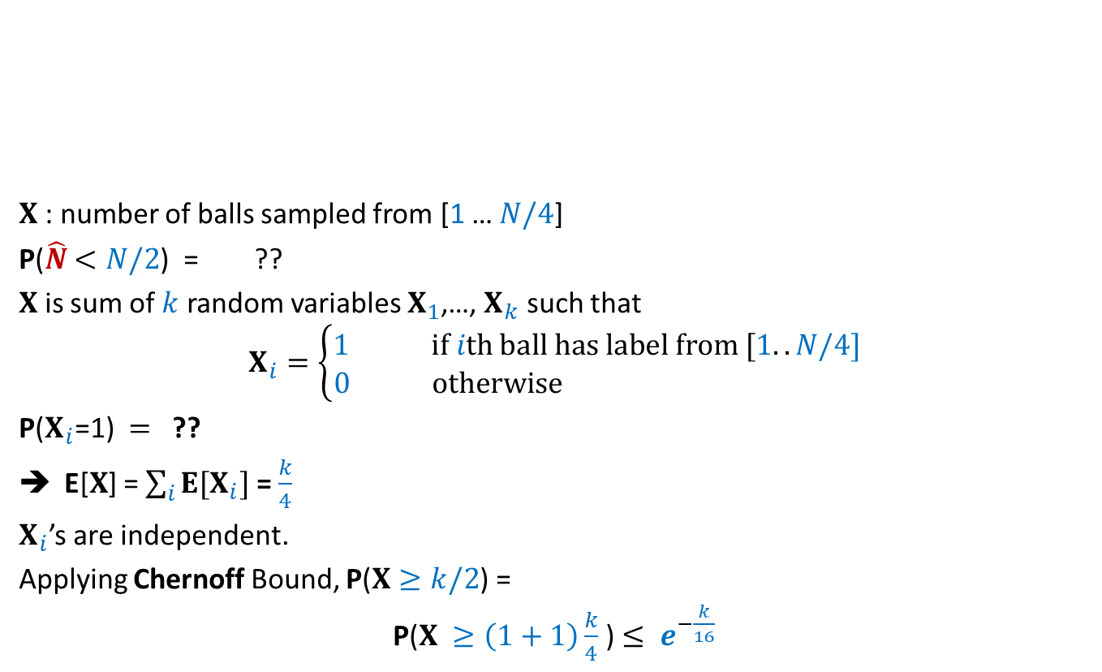




Question: What is P($\hat{N}$ $<N/2$) ?
$X$: number of balls sampled from [1 … $N/4$]
P($\hat{N}$ $<N/2$) = ??
$X$ is sum of $k$ random variables $X_{1}$,…, $X_{k}$ such that
$$X_{i}=\left\{\begin{aligned}1 if ith ball has label from [1..N/4] \\ 0 otherwise \end{aligned}\right.$$
P($X_{i}$=1) $=$ ??
E[$X$] = $\sum_{i}{E[X_{i}]}$ = $\frac{k}{4}$
$X_{i}$’s are independent.
Applying Chernoff Bound, P($X≥k/2$) =
P($X ≥\left(1+1\right)\frac{k}{4}$) $≤ e^{−\frac{k}{16}}$
1
2
$$N/4$$
N
P($X$>$k/2$)
$$¼$$

Slide 20
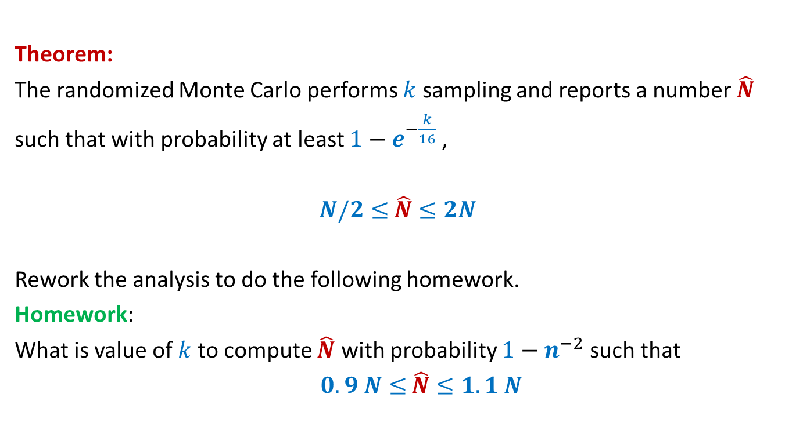
Final result
Theorem:
The randomized Monte Carlo performs $k$ sampling and reports a number $\hat{N}$
such that with probability at least $1−e^{−\frac{k}{16}}$ ,
$N/2≤$ $\hat{N}$ $≤2N$
Rework the analysis to do the following homework.
Homework:
What is value of $k$ to compute $\hat{N}$ with probability $1−n^{−2}$ such that
$0.9 N≤$ $\hat{N}$ $≤1.1 N$

Slide 21

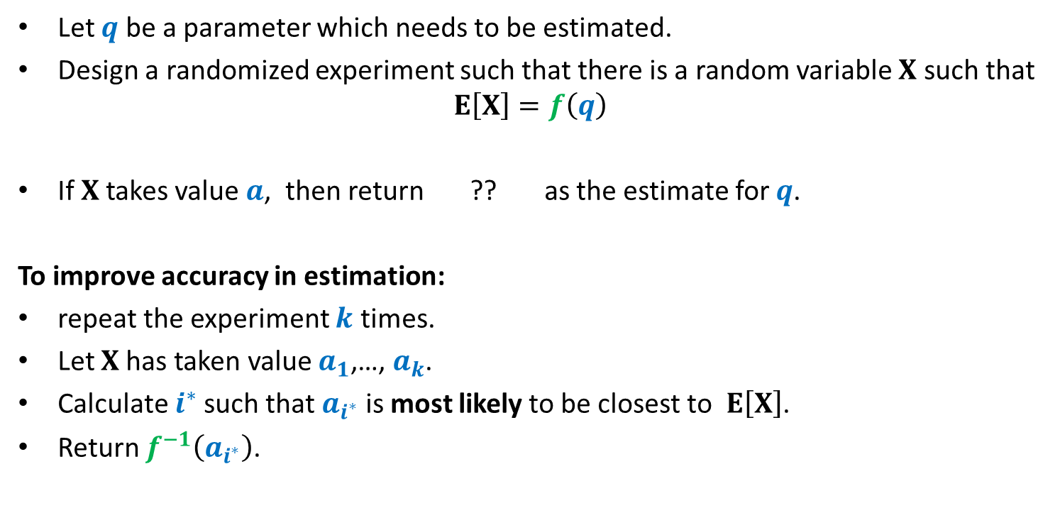
Randomized framework for estimating a parameter
Let $q$ be a parameter which needs to be estimated.
Design a randomized experiment such that there is a random variable $X$ such that
$$E\left[X\right]=f\left(q\right)$$
If $X$takes value $a$, then return ?? as the estimate for $q$.
To improve accuracy in estimation:
repeat the experiment $k$ times.
Let $X$has taken value $a_{1}$,…, $a_{k}$.
Calculate $i^{∗}$such that $a_{i^{∗}}$ is most likely to be closest to $E\left[X\right]$.
Return $f^{−1}\left(a_{i^{∗}}\right)$.
$$f^{−1}\left(a\right)$$

Slide 22
Estimating the size of Transitive Closure of a Directed Graph

Slide 23

$$x$$

Slide 24
$$x$$

Slide 25
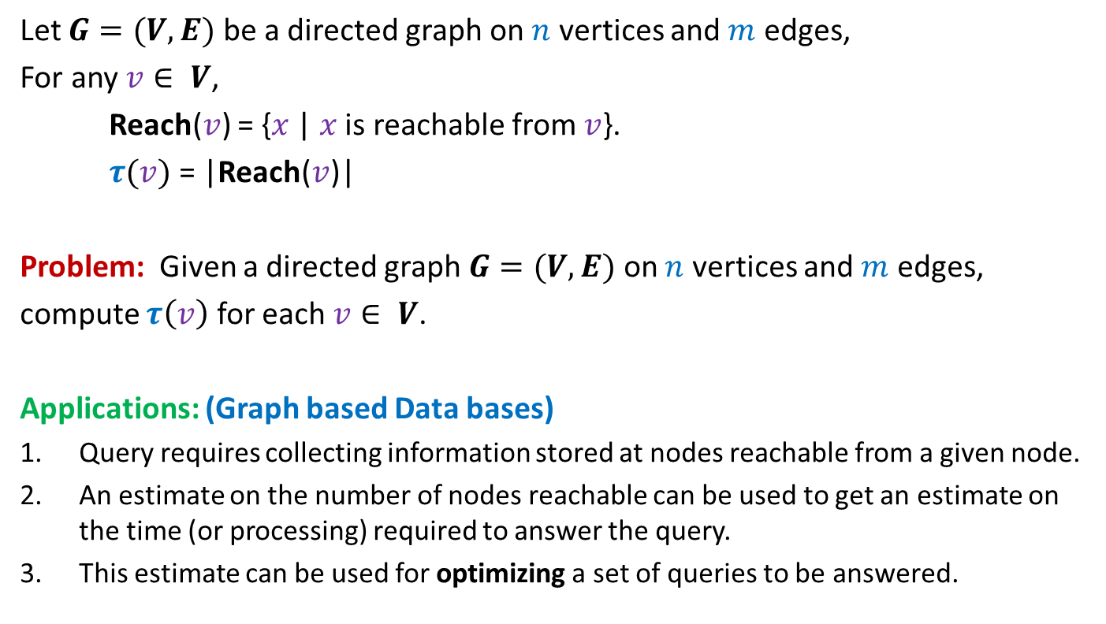
Estimating size of Transitive Closure of a Directed Graph
Let $G=(V,E)$ be a directed graph on $n$ vertices and $m$ edges,
For any $v∈ V$,
Reach($v$) = {$x$ | $x$ is reachable from $v$}.
$τ(v)$ = |Reach($v$)|
Problem: Given a directed graph $G=(V,E)$ on $n$ vertices and $m$ edges,
compute $τ\left(v\right)$ for each $v∈ V$.
Applications: (Graph based Data bases)
Query requires collecting information stored at nodes reachable from a given node.
An estimate on the number of nodes reachable can be used to get an estimate on the time (or processing) required to answer the query.
This estimate can be used for optimizing a set of queries to be answered.

Slide 26
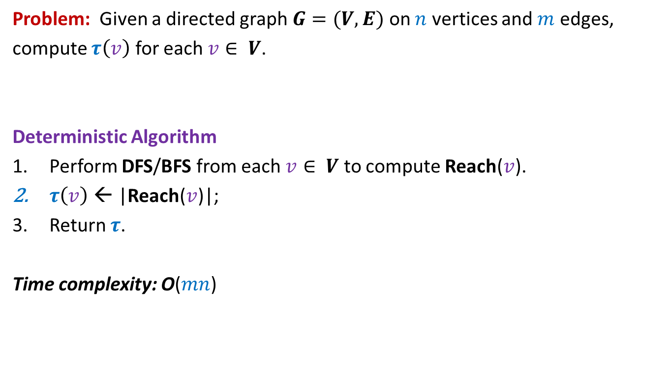
Estimating size of Transitive Closure of a Directed Graph
Problem: Given a directed graph $G=(V,E)$ on $n$ vertices and $m$ edges,
compute $τ\left(v\right)$ for each $v∈ V$.
Deterministic Algorithm
Perform DFS/BFS from each $v∈ V$ to compute Reach($v$).
$τ\left(v\right)$ ← |Reach($v$)|;
Return $τ$.
Time complexity: O($mn$)

Slide 27
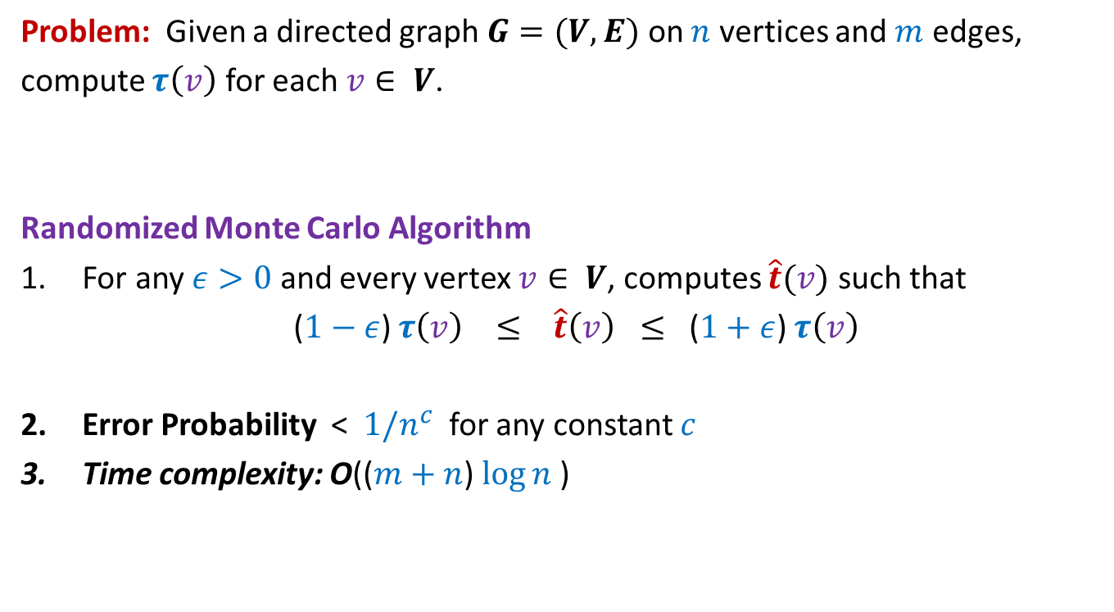
Estimating size of Transitive Closure of a Directed Graph
Problem: Given a directed graph $G=(V,E)$ on $n$ vertices and $m$ edges,
compute $τ\left(v\right)$ for each $v∈ V$.
Randomized Monte Carlo Algorithm
For any $ε>0$ and every vertex $v∈ V$, computes $\hat{t}(v)$ such that
($1−ε$) $τ\left(v\right) ≤ \hat{t}\left(v\right) ≤$ ($1+ε$) $τ\left(v\right)$
Error Probability < $1/n^{c}$ for any constant $c$
Time complexity: O(($m+n$) $\log{n}$)

Slide 28

Randomized Monte Carlo Algorithm for estimating the size of transitive closure of directed graph
Ingredients
A Deterministic O($m+n$) time algorithm for a problem “MinLabel”.
An inspirational probability problem.

Slide 29

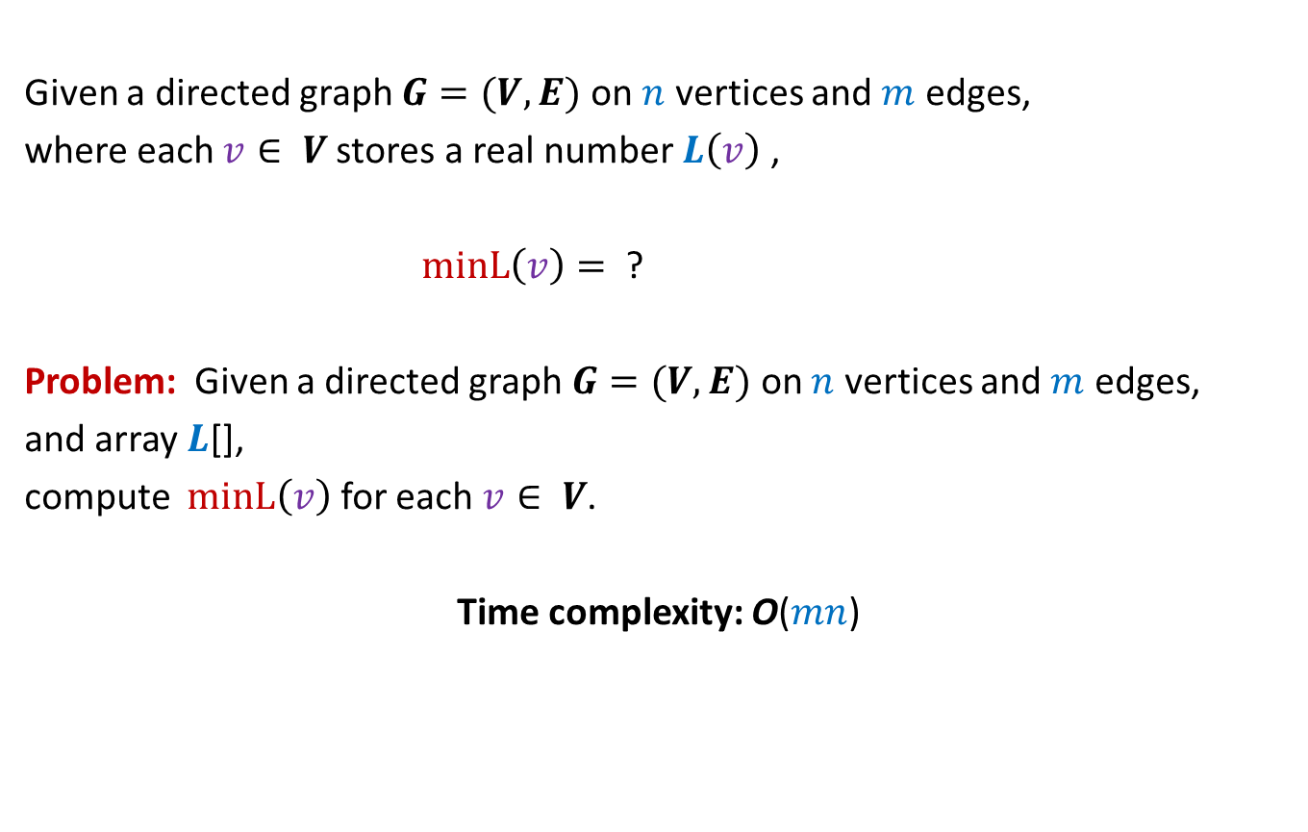

MIN-Label Problem
Given a directed graph $G=(V,E)$ on $n$ vertices and $m$ edges,
where each $v∈ V$stores a real number $L\left(v\right)$ ,
$minL\left(v\right)=$ ?
Problem: Given a directed graph $G=(V,E)$ on $n$ vertices and $m$ edges,
and array $L$[],
compute $minL\left(v\right)$ for each $v∈ V$.
Time complexity: O($mn$)
$$min\left\{L\left(x\right)\right| x \text{is} \text{reachable} \text{from} v\}$$
$$O(m+n\text{)}$$
The following two slides present two algorithms for this problem.
But, first make attempt on your own before studying these algorithms.

Slide 30

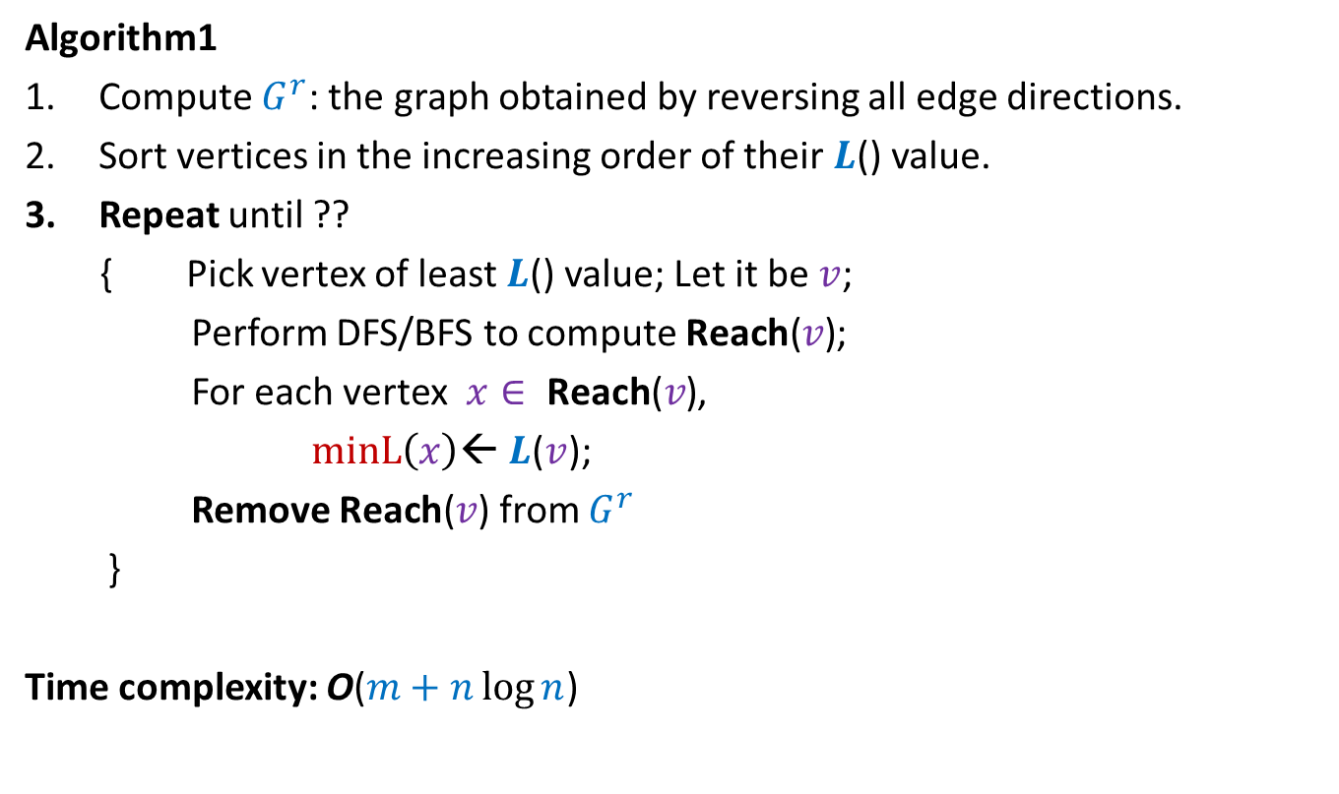
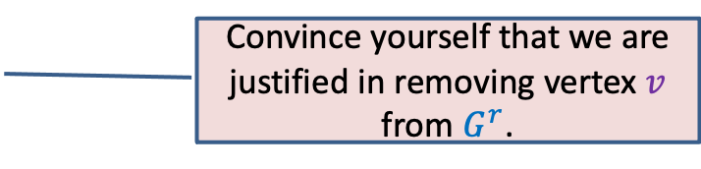
MIN-Label Problem
Algorithm1
Compute $G^{r}$: the graph obtained by reversing all edge directions.
Sort vertices in the increasing order of their $L$() value.
Repeat until ??
{ Pick vertex of least $L$() value; Let it be $v$;
Perform DFS/BFS to compute $\text{Reach}\text{(}v\text{)}$;
For each vertex $x∈ \text{Reach}\text{(}v\text{)}$,
$minL\left(x\right)$← $L$($v$);
Remove $\text{Reach}\text{(}v\text{)}$ from $G^{r}$
}
Time complexity: O($m+n\log{n}$)
$G^{r}$Is empty
Convince yourself that we are justified in removing vertex $v$ from $G^{r}$.

Slide 31
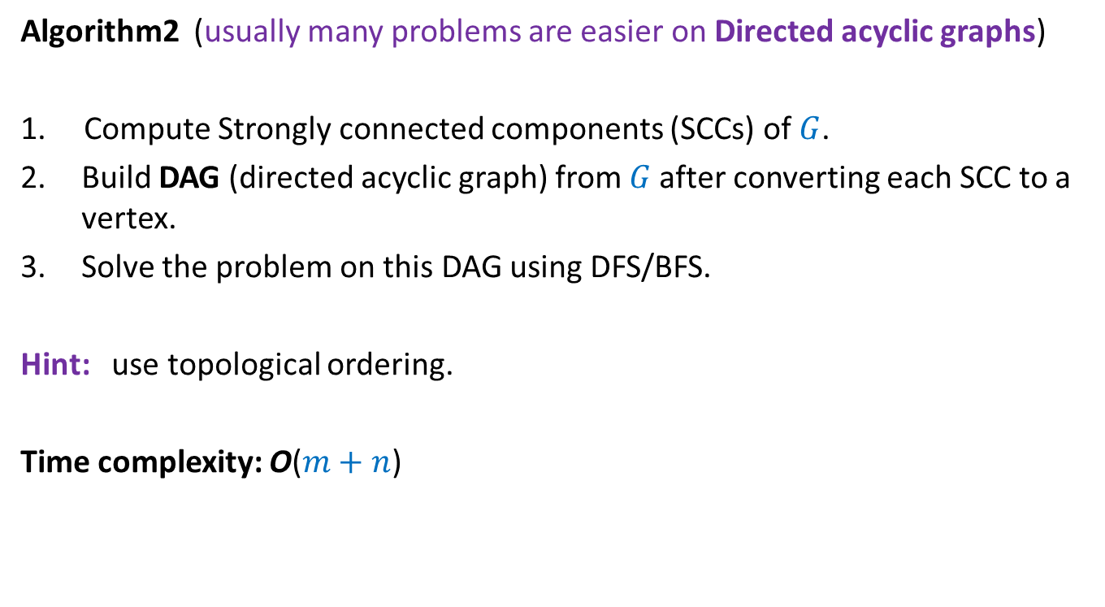
MIN-Label Problem
Algorithm2 (usually many problems are easier on Directed acyclic graphs)
1. Compute Strongly connected components (SCCs) of $G$.
Build DAG (directed acyclic graph) from $G$after converting each SCC to a vertex.
Solve the problem on this DAG using DFS/BFS.
Hint: use topological ordering.
Time complexity: O($m+n$)

Slide 32
An inspirational problem from continuous probability

Slide 33

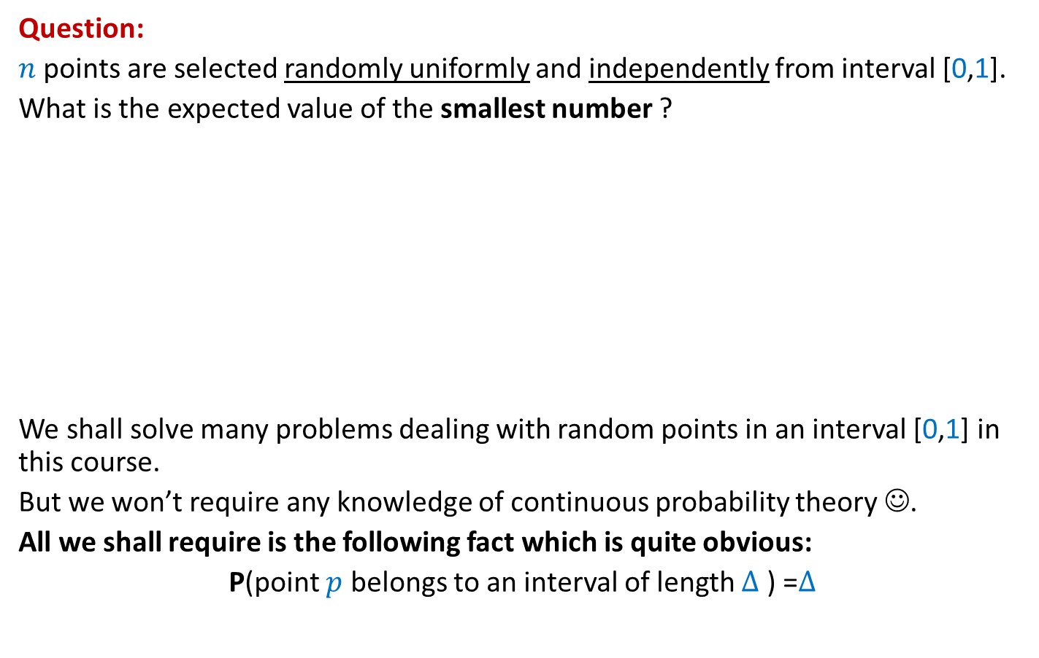



Question:
$n$ points are selected randomly uniformly and independently from interval [0,1].
What is the expected value of the smallest number ?
We shall solve many problems dealing with random points in an interval [0,1] in this course.
But we won’t require any knowledge of continuous probability theory ☺.
All we shall require is the following fact which is quite obvious:
P(point $p$ belongs to an interval of length $∆$ ) =$∆$
$$p$$
$$p$$
$$p$$
0
1
$$∆$$

Slide 34











Sampling points on a Circle (of circumference 1)
$$X_{n}$$
Question: What is E[$X_{i}]$ ?
➔ E[$X_{1}$]=E[$X_{2}$]= … = E[$X_{n}$]
E[$X_{1}$+$X_{2}+…X_{n}$]= ??
➔ E[$X_{1}$]= ??
$$X_{1}$$
$$X_{n−1}$$
$$X_{2}$$
$$X_{3}$$
$$X_{4}$$
Prob. distribution of $X_{i}$
Prob. distribution of $X_{j}$
$$1$$
$$1/n$$

Slide 35








Sampling points on a line segment
Question: What is E[$X_{i}]$ ?
Answer: ??
$$\frac{1}{n+1}$$
1
0
1
0
$$X_{n}$$
$$X_{n+1}$$
$$X_{1}$$
$$X_{2}$$
$$X_{3}$$
$$X_{4}$$

Slide 36
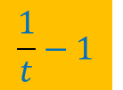
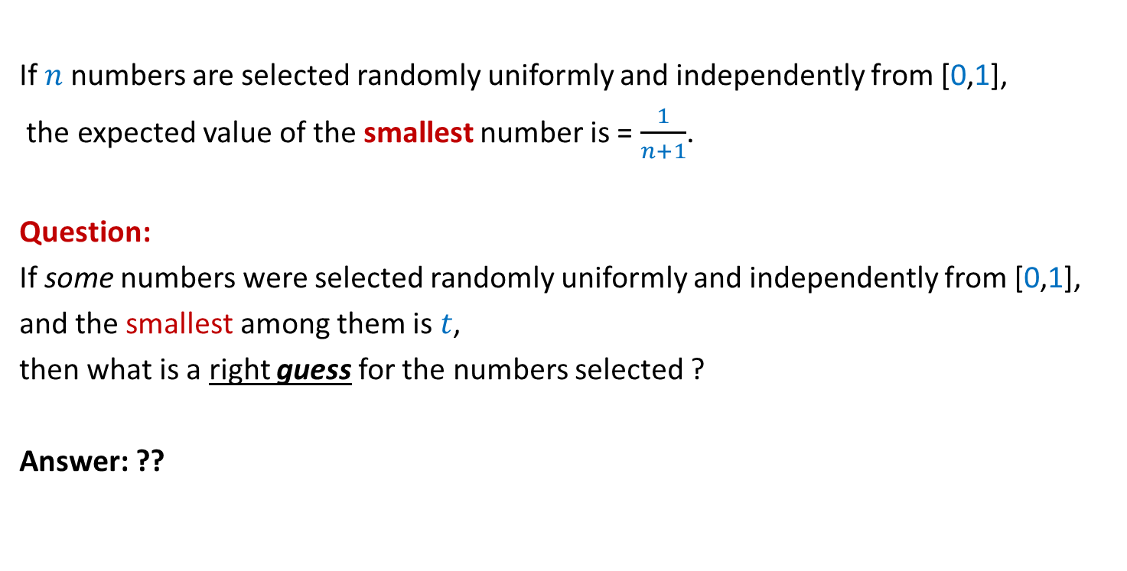
Inference from the inspirational problem
If $n$numbers are selected randomly uniformly and independently from [0,1],
the expected value of the smallest number is = $\frac{1}{n+1}$.
Question:
If some numbers were selected randomly uniformly and independently from [0,1],
and the smallest among them is $t$,
then what is a right guess for the numbers selected ?
Answer: ??
$$\frac{1}{t}−1$$
Spend some time now to design the algorithm based on this insight.

Slide 37
Randomized Monte Carlo algorithm
Estimating
the size of Transitive Closure
of a Directed Graph

Slide 38
$$x$$

Slide 39






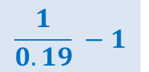

Suppose each vertex reachable from $x$ is assigned
a random no. uniformly distributed in the interval [$0,1$].
If we know the MinLabel($x$), how can we estimate $τ$($v$) ?
Can you now see the algorithm for estimating $τ$($v$) for all $v∈V$ ?
0.38
0.83
$$x$$
0.19
0.53
0.45
Estimate $\hat{τ}$($v$) :
$$\frac{1}{0.19} −1$$
$$=4.26$$
0.71
$$≈$$
$τ$($v$) :
$$=6$$

Slide 40
0.65
0.265
0.901
0.81
0.28
0.34
0.49
0.54
0.63
0.38
0.83
0.14
0.74
0.19
0.53
0.45
0.71

Slide 41
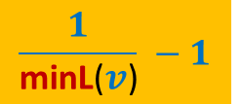
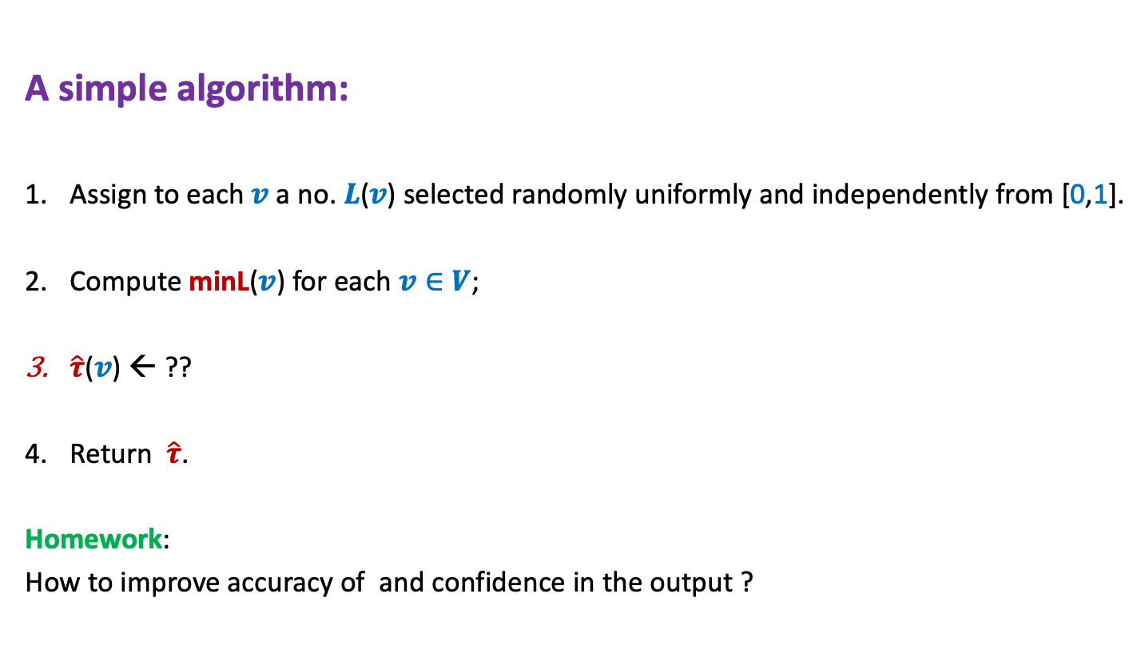
Estimating size of Transitive Closure of a Directed Graph
A simple algorithm:
Assign to each $v$ a no. $L$($v$) selected randomly uniformly and independently from [0,1].
Compute minL($v$) for each $v∈V$;
$\hat{τ}$($v$) ← ??
Return $\hat{τ}$.
Homework:
How to improve accuracy of and confidence in the output ?
$$\frac{1}{\text{minL}\text{(}v\text{)}} −1$$

